Slide 1



ISEC 0635: Information Security Operations Management
Winter Term 2023 Professor Ling Wang
Eric Webb
Assignment 2: Executive Summary of Lockheed Martin's Security and Assured Operations Management.

Slide 2


Lockheed Martin Overview
Lockheed Martin is one of the largest defense contractors in the world and has a global reach on the defense and aerospace industries. Lockheed has a strong reputation for innovation and excellence in its products and services. These can include fighter jets, helicopters, missiles, radar systems, spacecraft, energy, and advanced technologies for cybersecurity. Lockheed Martin came to be from a result of a merge between the Lockheed Corporation and Martin Marietta. Today they are committed to the advancement of Science, Technology, Engineering, and Math. (STEM)

Slide 3

Lockheed Martins Business Continuity Plan:
Introduction: Overviews the plans purpose, scope, and objectives of the BCP.
Business Impact Analysis: Performs an assessment of Lockheed's’ processes, systems, functions, and intellectual property that are critical for the organization to continue. The assessment is done to identify potential threats, vulnerabilities, and impacts.
Risk Management Strategy: Defined policies and procedures for identifying, assessing, and mitigating risks to critical business operations, assets, and data.
Crisis Management Strategy: Defined policies and procedures to manage crises, emergencies, and disasters effectively.
Business Continuity Strategy: Defined policies and procedures to ensure continuity of essential business operations during and after a disruptive event.
IT Disaster Recovery Plan: Defined policies and procedures to restore critical IT systems, networks, and data in the event of a disaster or outage.
Communication Plan: Defined policies and procedures to communicate effectively with all stakeholders, including employees, customers, vendors, and the public.
Training and Awareness: Training set in place so that employees can be educated on the business continuity plan and emergency response procedures.
Testing and Maintenance: Defined policies and procedures to conduct regular testing and maintenance of the business continuity plan to ensure its readiness and effectiveness.

Slide 4

Lockheed Martins Disaster Recovery Plan:
Introduction: Overviews the plans purpose, scope, and objectives of the DRP.
Disaster Recovery Team: A ledger of personnel responsible for executing the disaster recovery plan and their roles and responsibilities.
Risk Assessment: An assessment of potential risks and vulnerabilities to critical infrastructure such as natural disasters, cyberattacks, and other potential disruptions.
Backup and Recovery Strategy: Policies and procedures for backing up critical data and proprietary systems and recovering them in the event of a disaster or outage.
Emergency Response Plan: Policies and procedures for responding to an emergency, such as evacuating personnel, securing facilities, and mitigating damage.
Communication Plan: Policies and procedures to communicate effectively with all stakeholders, including employees, customers, vendors, and the public.
Testing and Maintenance: Policies and procedures to conduct regular testing and maintenance of the disaster recovery plan. This is to ensure its effectiveness and readiness.
Training and Awareness: Policies and procedures to train employees on the disaster recovery plan, emergency response procedures, and other critical components of continuity management.
Continuous Improvement: Policies and procedures to continuously review, critique, and improve the disaster recovery plan based on lessons learned from previous events, industry standards, and advancements in technologies.

Slide 5

Lockheed Martins Incident Response Plan:
Introduction: Overviews the plans purpose, scope, and objectives of the IRP.
Incident Response Team: A defined ledger of the employees responsible for executing the incident response plan along with their roles and responsibilities.
Threat Assessment: An assessment of potential threats and vulnerabilities to organizational intellectual property, including internal and external threats. Along with methods for detecting and monitoring them.
Incident Response Procedures: Defined Policies and procedures for responding to an incident related to intellectual property, including containment, investigation, recovery, and reporting.
Evidence Collection: Policies and procedures for collecting and preserving evidence related to the incident, such as documentation, forensic analysis, and a chain of custody.
Legal and Regulatory Compliance: Policies and procedures for obeying legal and regulatory requirements such as data privacy laws and contract obligations.
Communication Plan: Policies and procedures to communicate effectively with all stakeholders, including employees, customers, vendors, and law enforcement.
Training and Awareness: Training for employees on the incident response plan, security policies and procedures, and other critical aspects of intellectual property protection.
Continuous Improvement: Policies and procedures for continuous review, critique, and improvement of the incident response plan. Based on lessons learned from previous incidents, industry standards, and advancements in technologies.

Slide 6
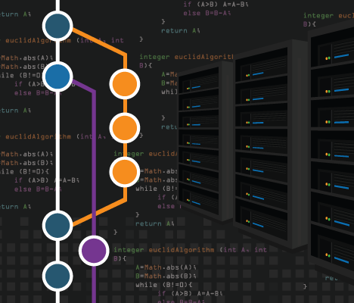
Lockheed Martins Version Control System Assured Operations Plan:
Objective: The following assured operations plan documents policies and procedures to protect intellectual property, implement access controls, and maintain patch and change management for Lockheed Martin’s codebase stored on GitHub and physical backups. This will lead to the assured operation of Lockheed's Version Control Systems and protect the proprietary intellectual property they contain.

Slide 7

Protection of Organizational Intellectual Property Through Version Control.
Access Control: Only authorized personnel should have access to the organization's codebase. This includes limiting access to the codebase by using access control on GitHub so that only designated individuals can read, write, or change access.
Encryption: Sensitive information should be encrypted to and from GitHub and among all network traffic.
Two-Factor Authentication: Two-factor authentication should be implemented to prevent unauthorized access to the codebase such as a RSA-Token.
Strong Password Policy: A strong password policy should be enforced to ensure that access to the codebase is only granted to authorized employees.
Limit Physical Access: Physical access to the organization's servers, workstations, and backups should be limited to authorized personnel.
Key Management: Private keys should be stored as environment variables and not directly in codebase. Along with other secure key management practices.

Slide 8
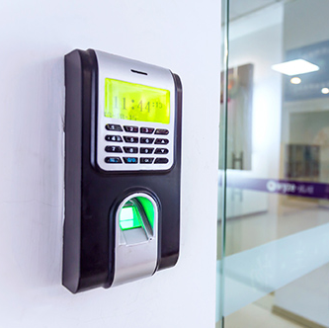
Implementation of Access Controls Including Cyber-Physical Security Controls:
Firewall: Firewalls should be installed and configured to protect the organization's network from unauthorized access to networks linked to the codebase or backups.
Intrusion Detection System: An intrusion detection system should be implemented to detect any irregular attempts to access the organization's codebase or network.
Cyber-Physical Security Controls: Physical access to the organization's codebase and physical backups should be limited and secured to prevent unauthorized access.
Regular Security Audits: Regular security audits should be conducted to ensure that the organization's codebase and network are secure.
GitHub Access Control: This includes limiting access to the codebase by using access control on GitHub so that only designated individuals can read, write, or change access.

Slide 9

Patch and Change Management:
Regular Updates: Regular updates are applied to Lockheed's software and systems to ensure that vulnerabilities are addressed in a timely manner.
Testing: Changes to Lockheed's Source Control Management procedures should be thoroughly tested before being deployed to ensure that they do not introduce vulnerabilities.
Version Control: Version control should be used to track changes made to the organization's codebase.
Backup and Recovery: Regular backups of the organization's codebase should be made and should be tested to ensure that it can be restored in the event of a disaster or system failure.

Slide 10
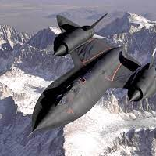
Conclusion
This Assured Operations Plan is designed to protect Lockheed Martin's intellectual property by implementing access controls, cyber-physical security controls, and maintaining patch and change management of the organization's codebase which is primarily stored on GitHub and on physical backups. The plan helps protect Lockheed's proprietary codebase from unauthorized access and vulnerabilities. Regular backups are made to ensure that the codebase can be restored in the event of a disaster and there is verified checks that the backups work.

Slide 11

Strategic Roles of the Organizational Stakeholders
Board of Directors: Ensures that adequate resources are provided to establish and maintain an effective security program and sets the policies that guide the organization's security while also overseeing the management team to ensure that security risks and assured operations are appropriately managed.
Senior Management: Responsible for following the board's security policies and ensuring the organization's security program aligns with business objectives. Ensures that resources are allocated to maintain an effective security program. Senior management makes crucial decisions about balancing risk vs cost to ensure the organization remains operationally secure.
Chief Information Security Officer (CISO): Responsible for developing and executing the organization's security and operational assurance strategy while ensuring that the security program aligns with objectives, complies with laws and regulations, and manages risk. The CISO oversees the organization's security operations and provide guidance to other stakeholders on security matters.
IT Management (CIO, IT Director, etc.): Responsible for managing security controls necessary for an effective security and assured operations program and ensures that security measures are consistent with the organization's security policies and standards. They oversee the day-to-day management of the organization's security and assured operations.
Functional Area Management: Responsible for managing the security risks within their respective areas and ensure that adequate controls are in place to protect sensitive data and systems within their jurisdiction. Functional Area Management works with IT management to implement security controls and ensure compliance with the organization's security policies and assured operation standards.
Information Security personnel: Responsible for the day-to-day implementation of the organization's security program and manage the technical aspects of the security program, including firewalls, intrusion detection systems, and security incident response. They work with other stakeholders to identify and mitigate security and assured operations risks.
End users (employees, customers, sub-contractors/vendors, etc.): Responsible for maintaining an effective security and assured operations program. They are responsible for abiding by the organization's security policies and standards, reporting security incidents, and participating in security awareness training.

Slide 12

Three Big Challenges When it Comes to Assured Operations and Contingency Plans:
Funding: Can be challenging when it comes to implementing assured operations contingency plans. Organizations may not have the resource funding allocated to establish all the necessary security measures for assured operations.
Resource Allocation: Can be a challenging when it comes to implementing assured operations contingency plans. Even if organizations have the necessary funding there might be competing priorities for those resources within the company. This can lead to challenges allocating resources if other priorities seem more pressing. Particularly, when it comes to compliance because those resources may need to be allocated to remain compliant.
Communication: Is critical to the success of the organization's security and assured operations posture. Without proper communication stakeholders might not be cognizant of the threats imposed if resources are not properly allocated. Another example of the need to communicate is when stakeholders are resistant to change. Great communication is needed between the stakeholders to implement and decide if the changes are propelling the organization in the proper direction.

